Slide 1
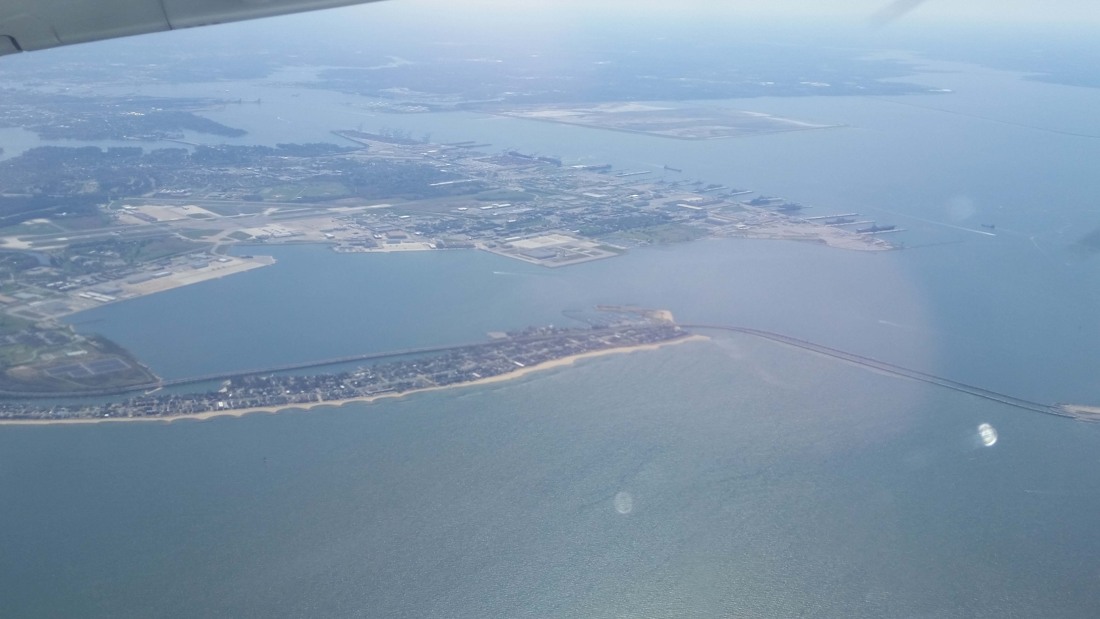

Current Best Practice: Decision Making Under Uncertainty (DMUU)
Planning and preparing for a (somewhat) predictable future
Next Best Practice: Decision Making Under Foreseeability (DMUF):
Preparing for what is foreseeable (what might happen),
anticipating surprises,
developing general resilience.
foreseeability
reasonable anticipation of the possible results of an action, such as what may happen if one is negligent or consequential damages resulting from breach of a contract.
Hans-Peter Plag
September 16, 2015

Slide 2
What is foreseeable?
The baseline for climate change
The symptom
The diagnosis
The prognosis
The therapy
foreseeability
reasonable anticipation of the possible results of an action, such as what may happen if one is negligent or consequential damages resulting from breach of a contract.
Hans-Peter Plag
September 16, 2015

Slide 3
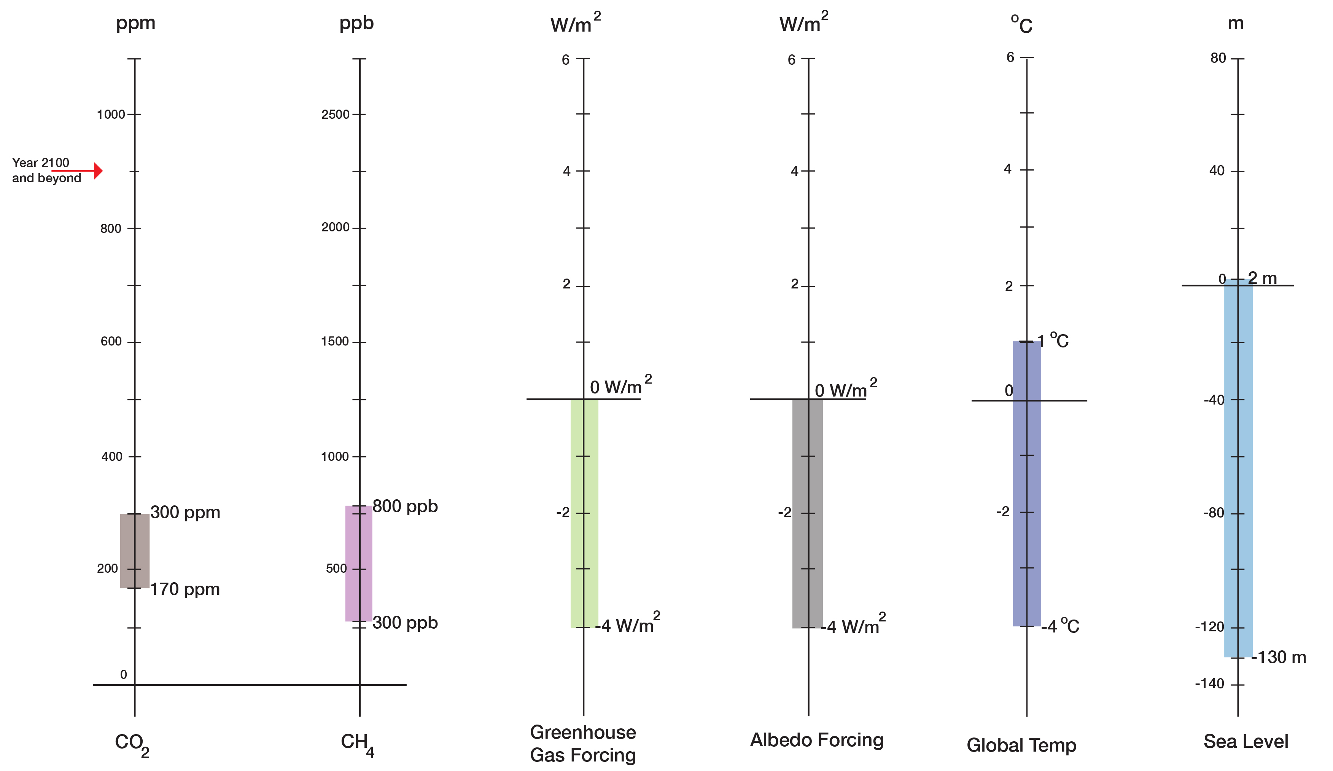
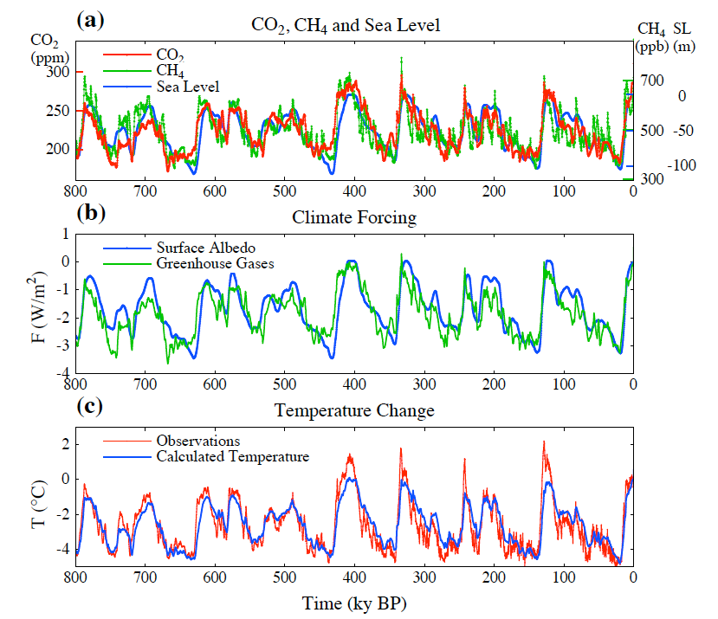
Long-term (centuries to millennia) correlations:
130 ppm CO2 <=> 5ºC
130 ppm CO2 <=> 130 m in sea level
Normal Range up to 1900
Holocene

Slide 4
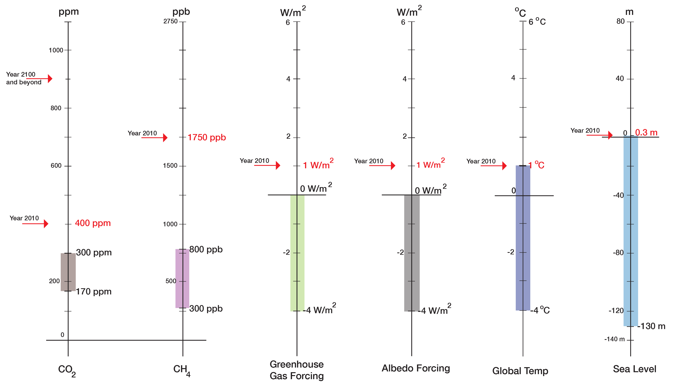
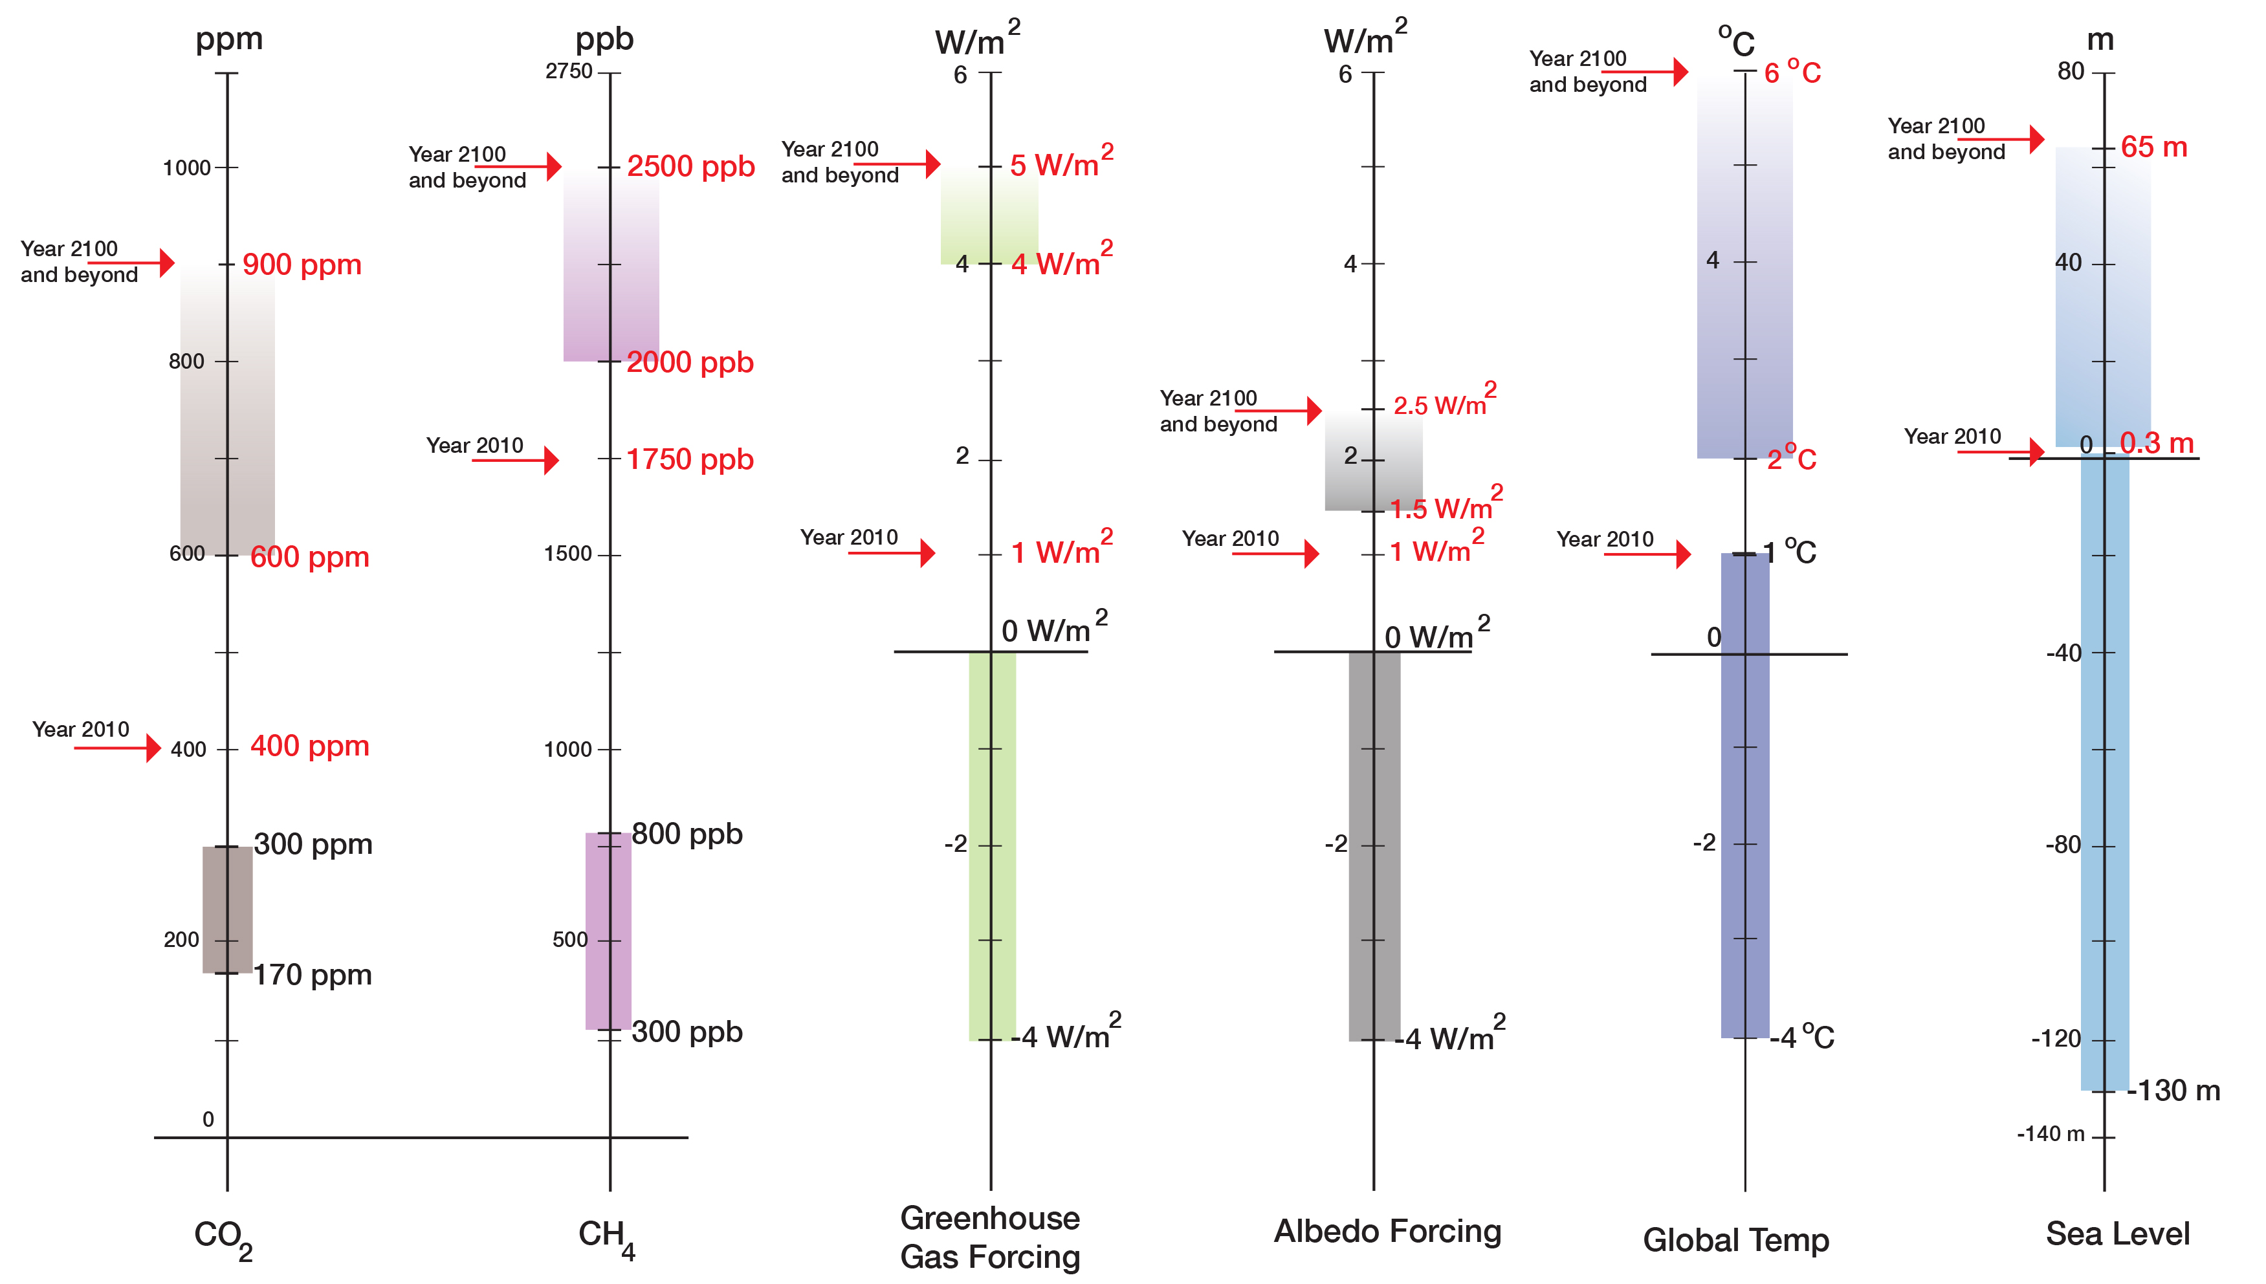
“Prognosis”
“Current State”
“Normal Range”
(800,000 years)

Slide 5
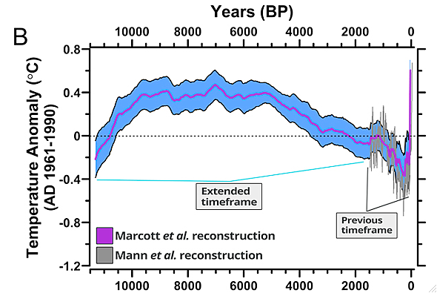
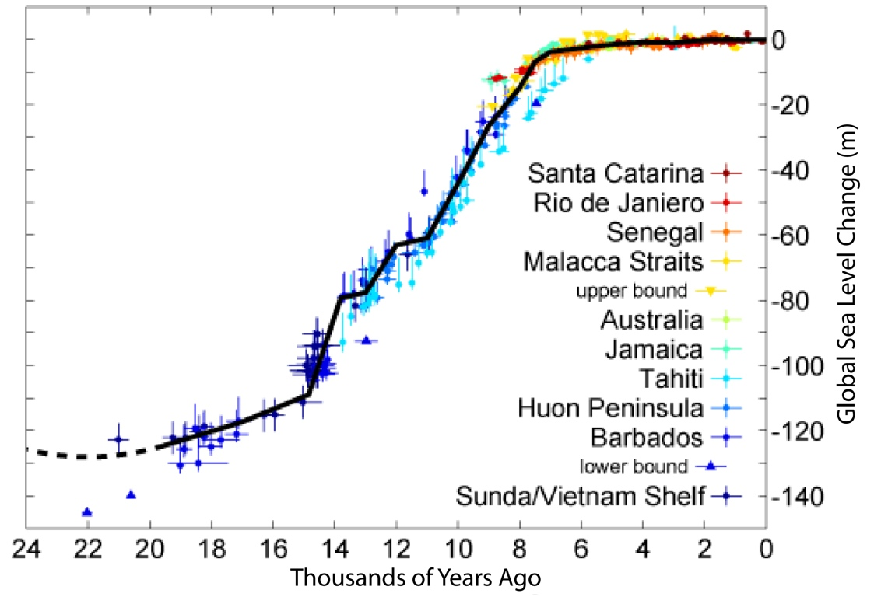
Global Temperature Changes
Global Sea Level Changes
<--Holocene-->
<------------Holocene------------>
The Baseline for Civilization:
During the Holocene, climate, global temperature, and sea level were exceptionally stable; a perfect condition for the development of civilization.
The Holocene was a “safe operating space for humanity”
Marcott et al., 2013

Slide 6
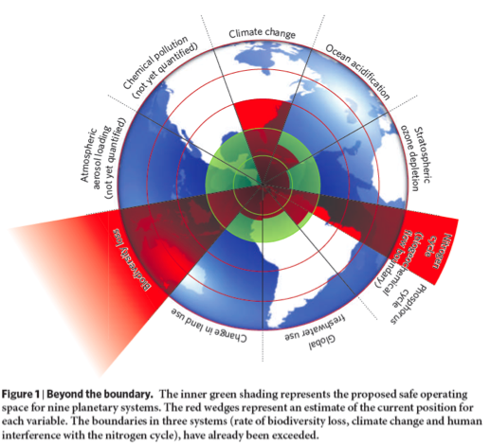
We are moving out of the Holocene and the “safe operating space for humanity” (Rockstroem et al., 2009):
Climate Change (***)
Ocean acidification (**)
Stratospheric ozone depletion (*)
Nitrogen (******) and Phosphorous cycles (**)
Global freshwater (*)
Change in land use (*)
Biodiversity loss (*******)
Atmospheric aerosols (?)
Chemical pollution (?)
Climate change and sea level rise are symptoms, not the cause,
the “sickness.”

Slide 7
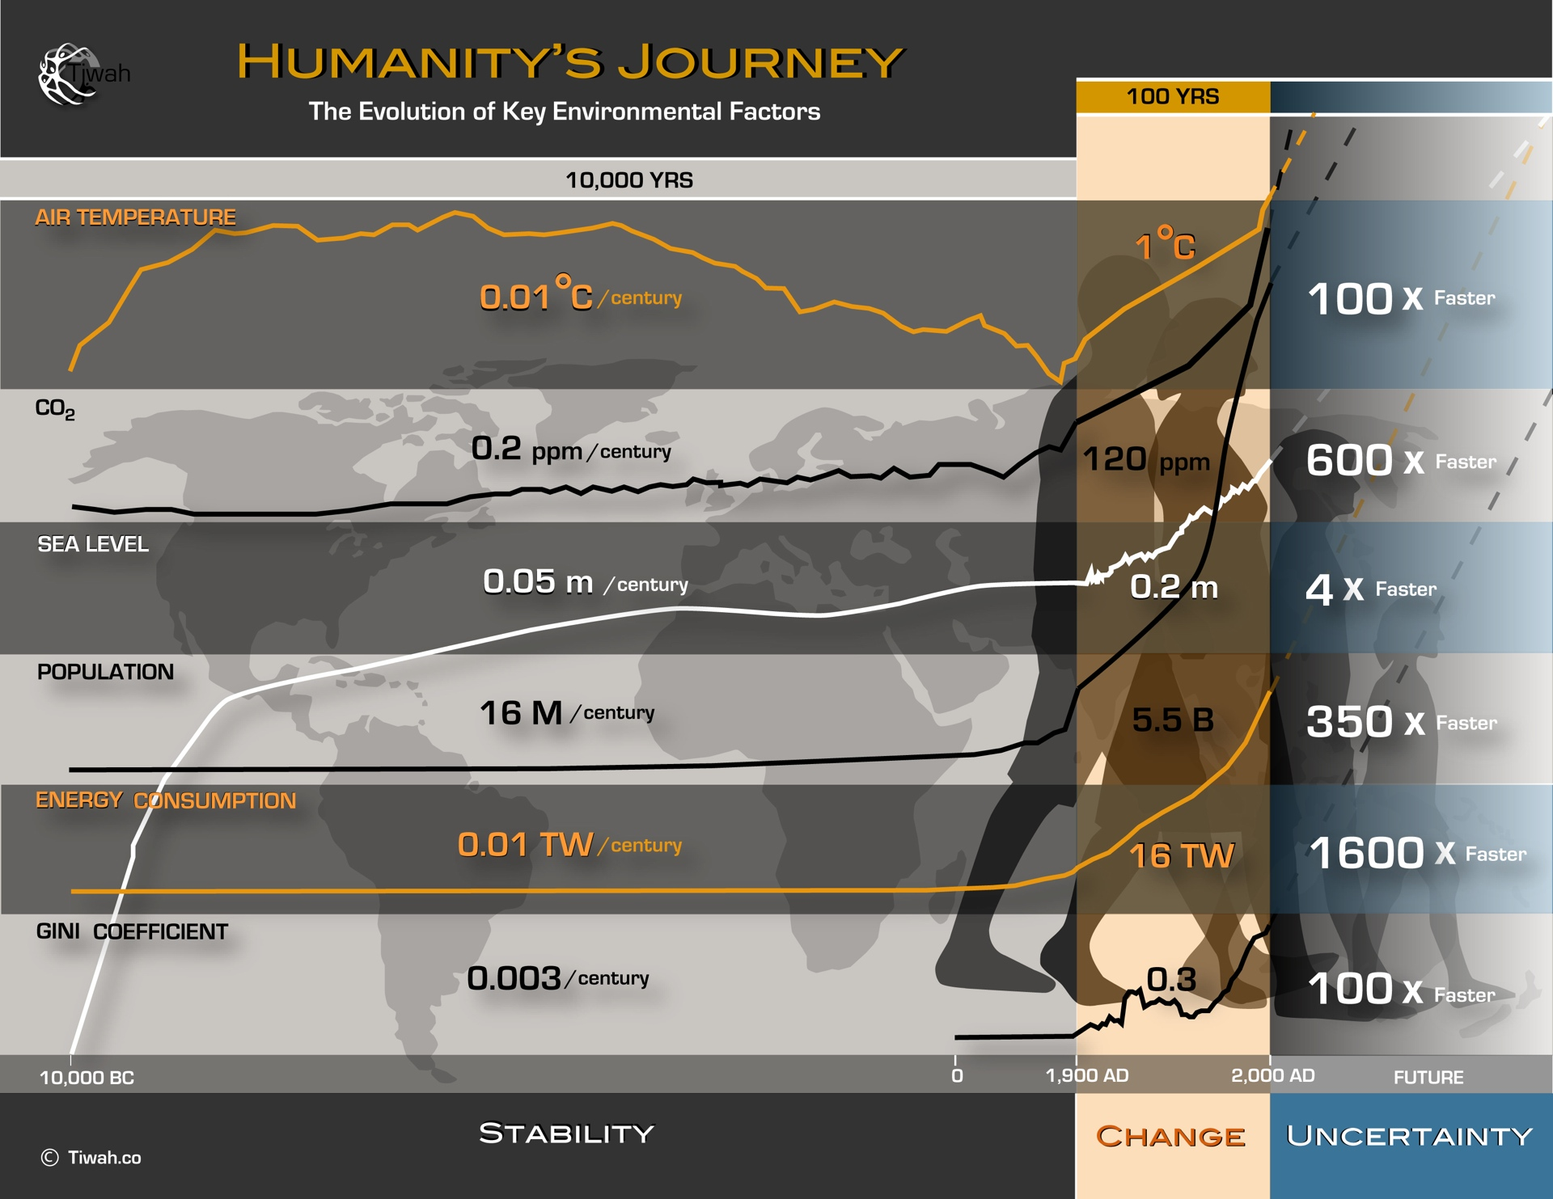
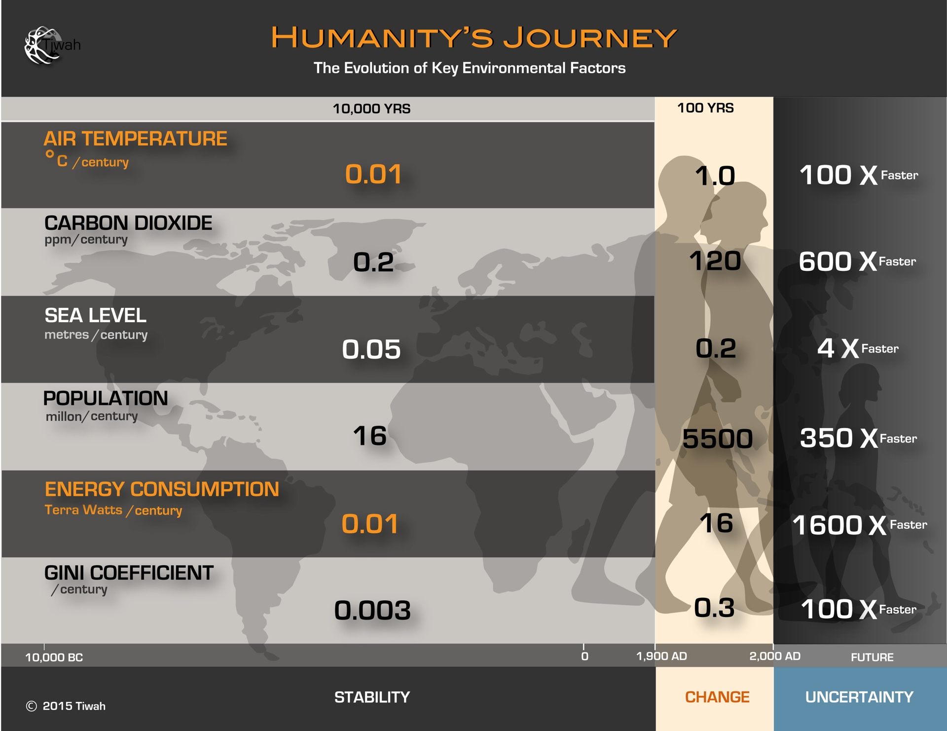
Holocene:
Stability
20th and 21st Century:
Change, imbalance
Future:
Uncertainty

Slide 8
}
4
<--Post-Holocene
3
IPCC Assessment:
Very Likely by 2100
2
o
1 C
<--Holocene--->
Marcott et al., 2013

Slide 9
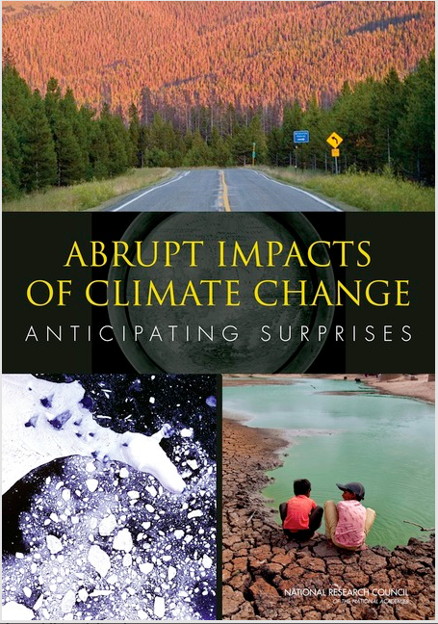
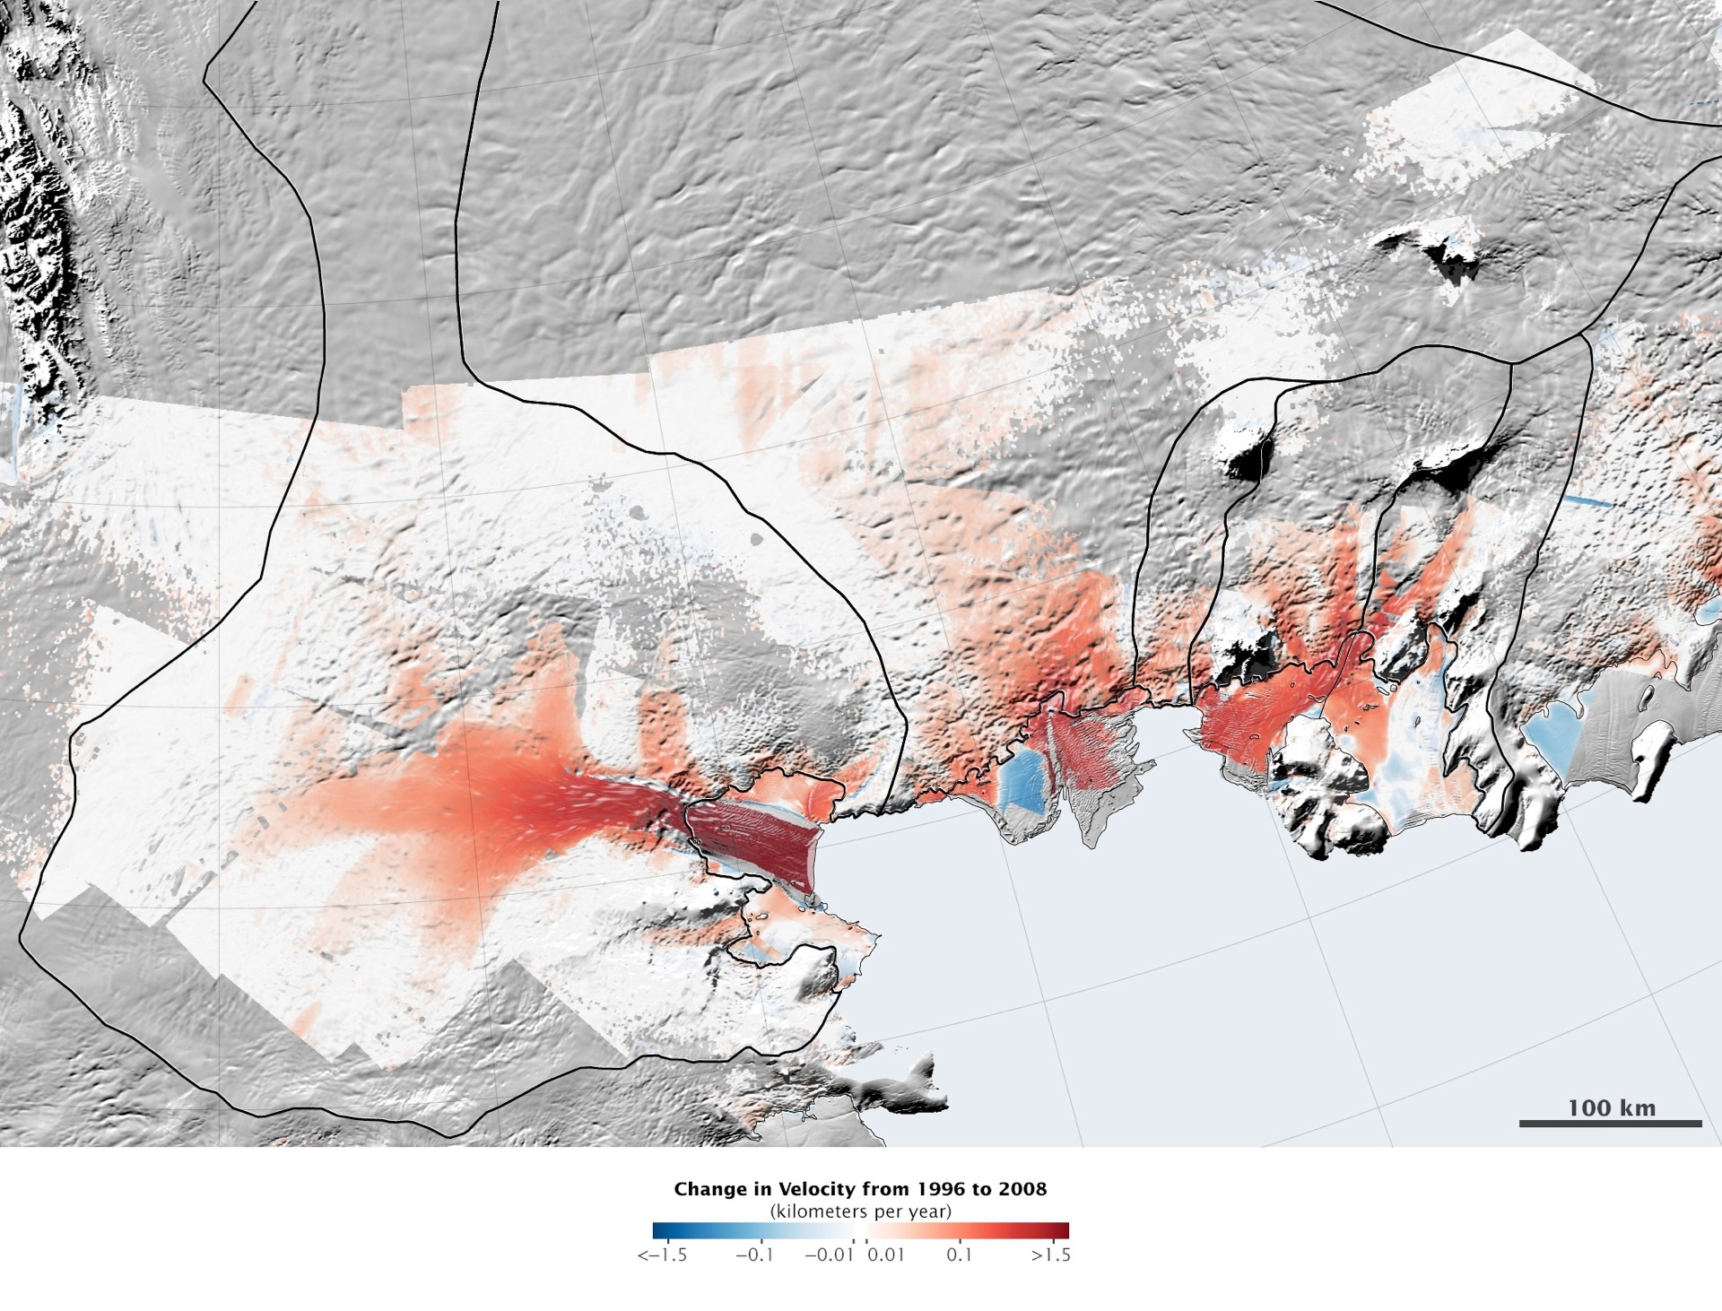
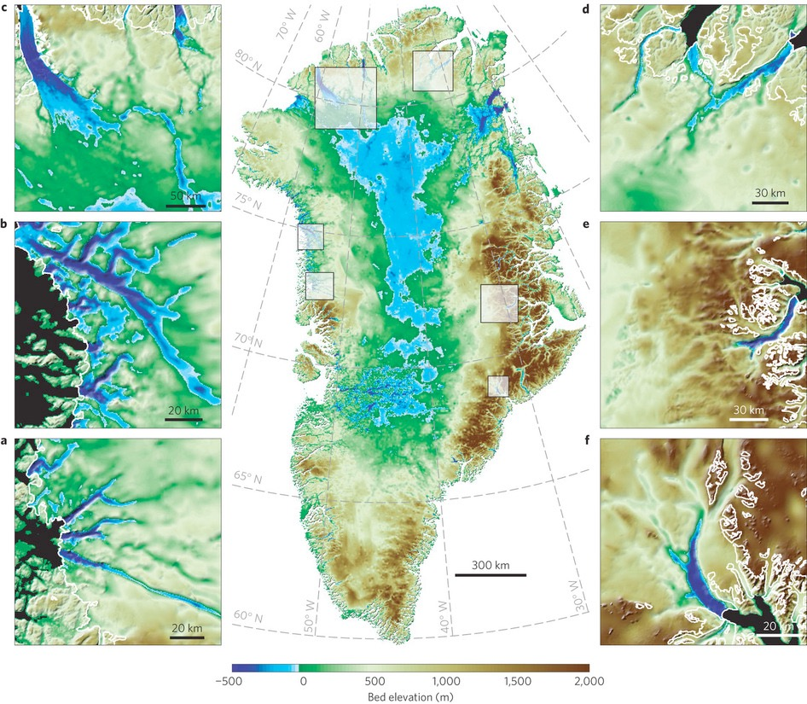
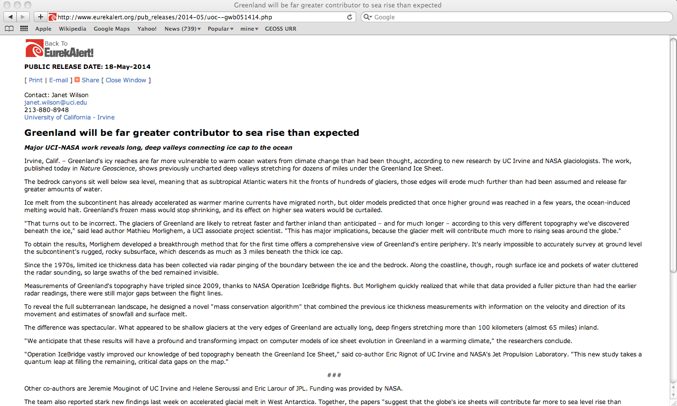
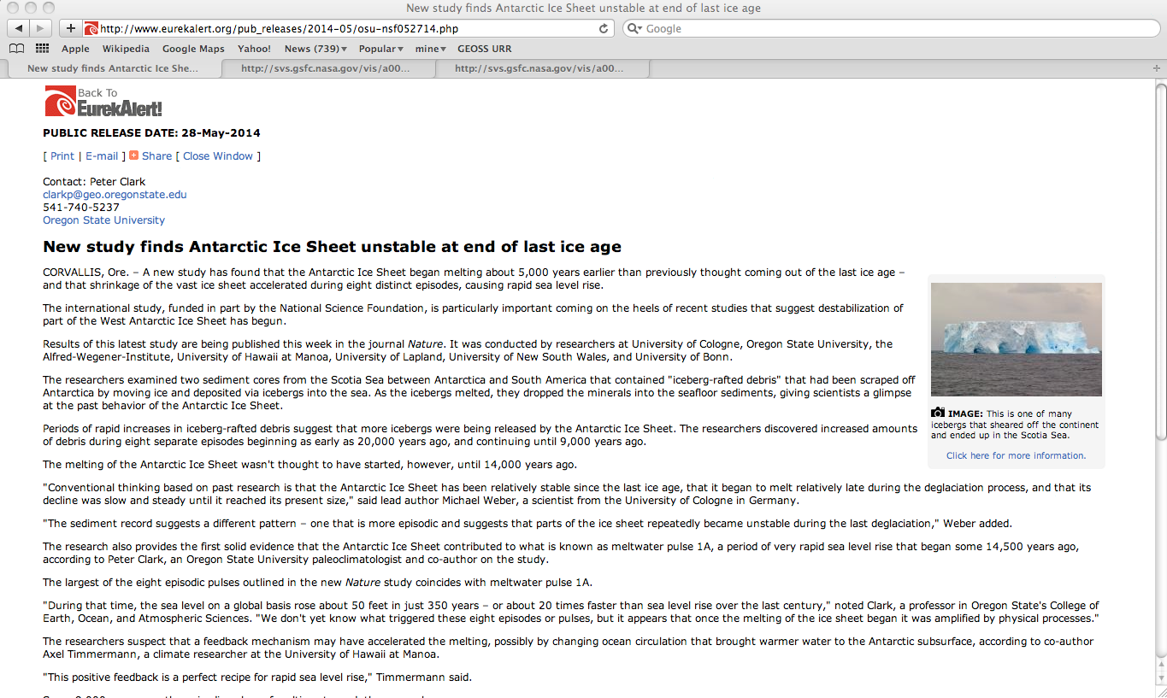
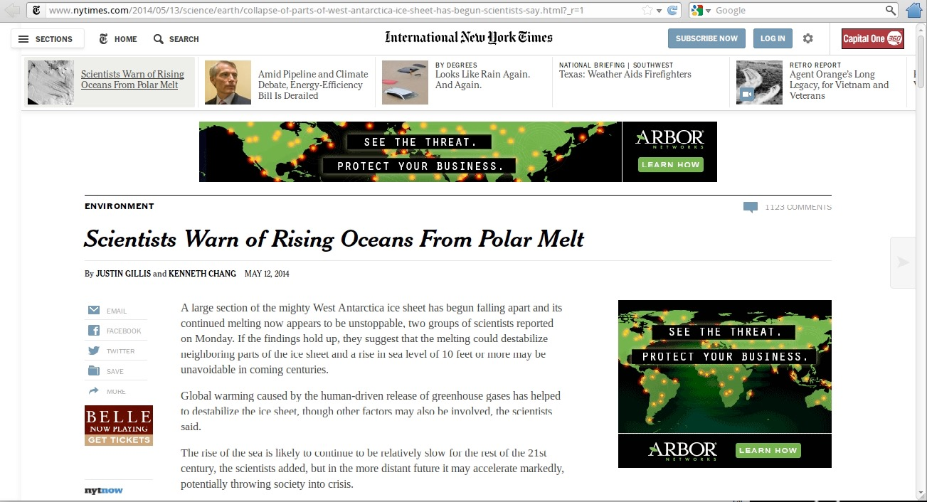
May 12, 2014: A large section of the mighty West Antarctic ice sheet has begun falling apart ... That’s enough ice to raise global sea level by more than 15 ft. (4.6 m)
August 29, 2015: “The critical question thus becomes: Is Greenland likely to lose even more ice than it’s currently losing per year — and could Antarctica do the same?”
National Research Council in 2013:
There is the potential for surprises and new extremes ...
Hansen et al., 2015: “… Evidence … that 2ºC global warming is highly dangerous.”
May 18, 2014: The glaciers of Greenland are likely to retreat faster and further inland than anticipated ....
May 28, 2014: During that time, the sea level on a global basis rose about 50 feet in just 350 years

Slide 10
WAIS Contribution to Global Sea Level
Accepted knowledge in 2000:
Greenland: no significant contribution to sea level rise
Antarctica: minor contribution
Main contribution: steric changes
4.5 m
Knowledge in 2015:
Greenland: is contributing, is accelerating, potentially a large contribution to sea level rise;
increasing potential for a large contribution due to deep warm water around Greenland
Antarctica: West Antarctic ice sheet (WAIS) will contribute 4.5 m
800 Years?
100 Years?
How worried should we be?

Slide 11
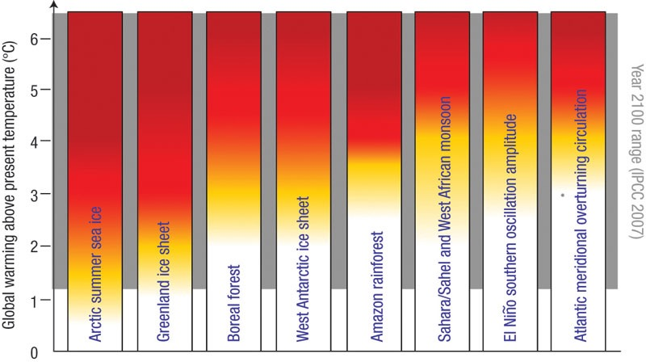
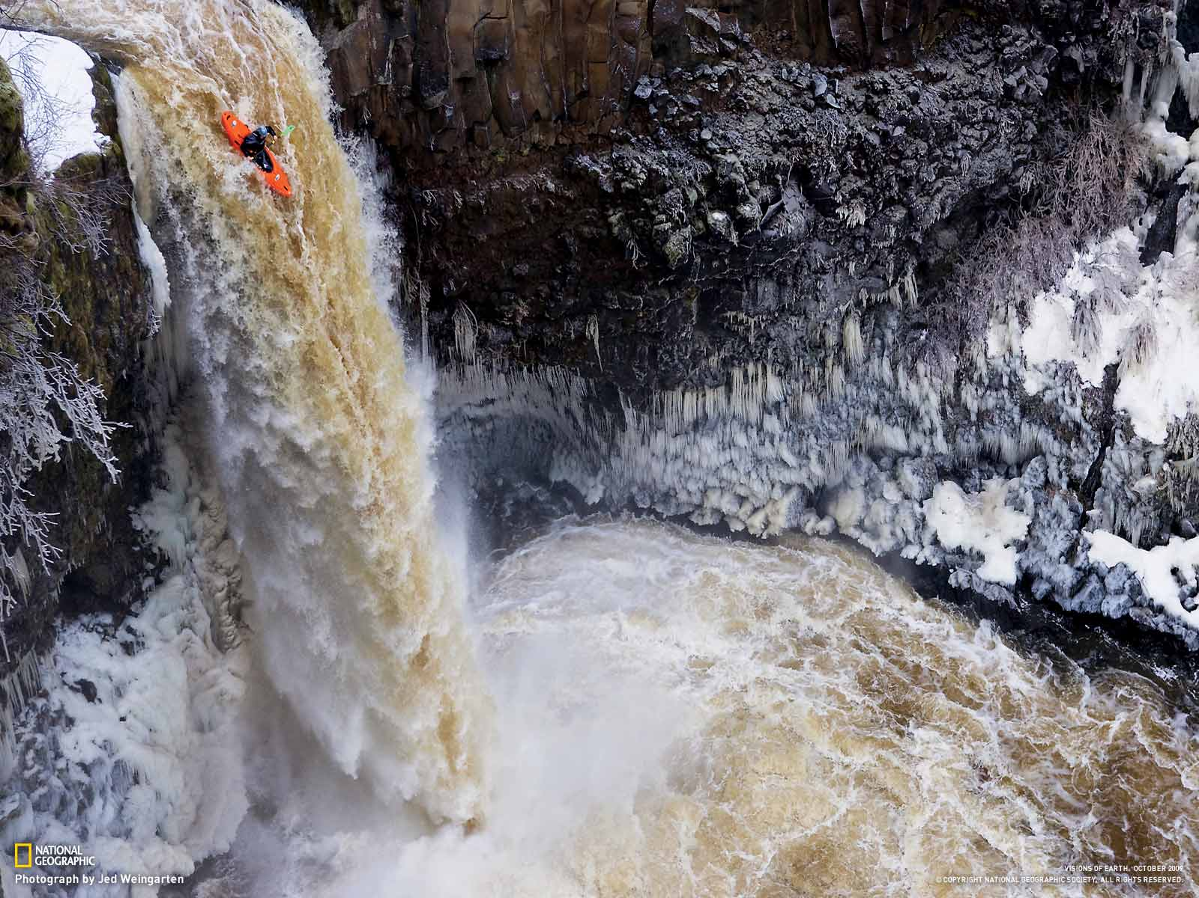
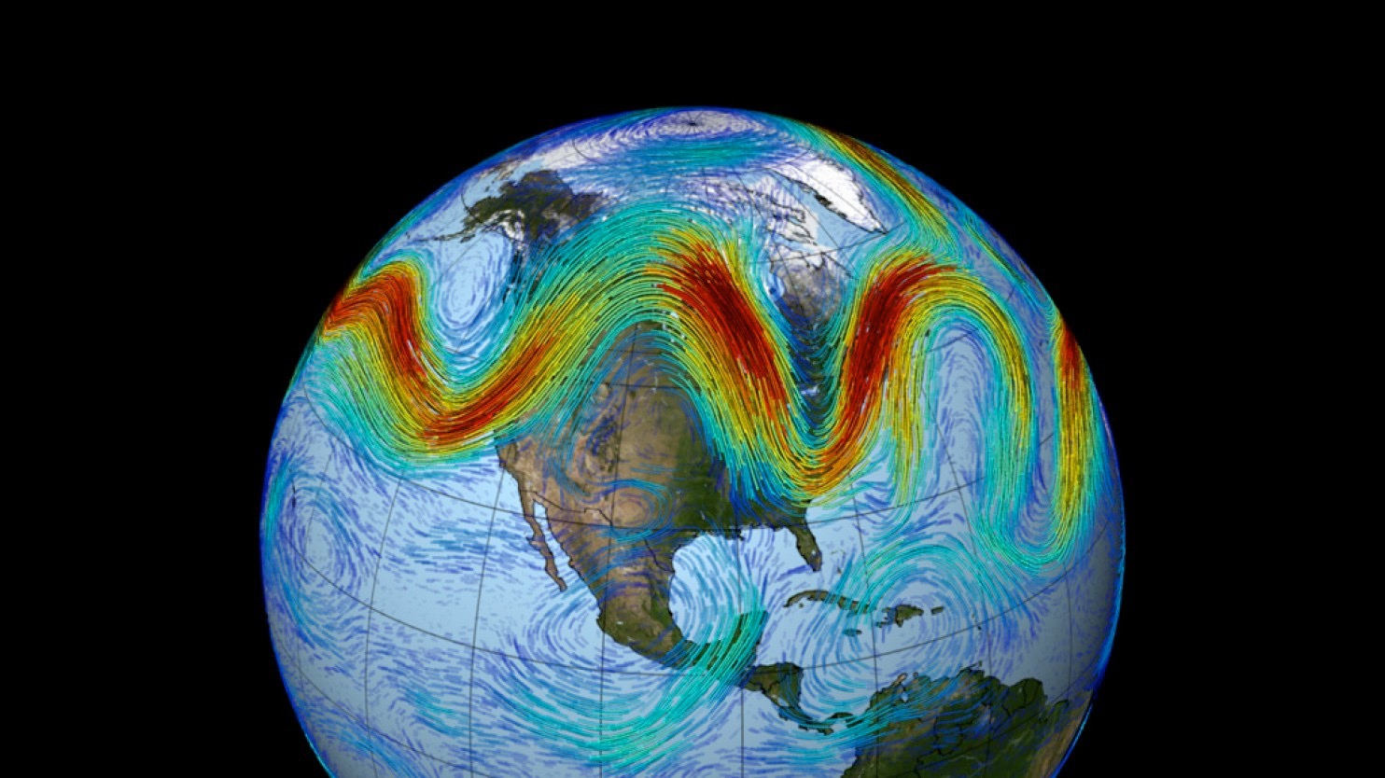
Understanding thresholds
The threshold is not where the boat goes over the edge, it is far up the river, when the people in the boat lose the option to get to the shore
On a big, unknown river, don’t go into the middle, stay close to the shore
      Jim White
      Many thresholds, including climate change related ones …
Lenton & Schellnhuber (2007) Nature Reports Climate Change
      The warming of the Arctic could be a threshold we have crossed ...
      Francis and Vavrus, 2015

Slide 12
Hansen et al., 2015: “… Evidence … that 2ºC global warming is highly dangerous.”
Our Commitment: The “~400 ppm CO2 World”:
Example: Mid-Pliocene, 3.3 to 3.0 Million Years ago
Temperature: ~1 - 2 ºC higher
Sea level:
global average on the order of 25 m higher than today
regionally 5 to 40 m higher;
most likely, much stronger storms due to larger temperature difference between tropics and polar regions

Slide 13



SUSTAINABILITY:
How difficult is it to keep a system within the sustainable range?
It depends...
Stable system, linear response
Unstable system,
non-linear response
Notes:
Explain:

Slide 14
Decision Making Under Uncertainty (DMUU):
Planning and preparing for a (somewhat) predictable future
Choose a range of plausible trajectories (for droughts, heat waves, sea level rise, extreme events, ...)
Determine the range of risks to be reduced based on these trajectories and vulnerabilities
Adapt land use, building codes, protective measures accordingly
Decision Making Under Foreseeability (DMUF):
Preparing for the possible and surprises, developing general resilience
Knowing the “worst case” and facilitate adaptation to unpredictable future:
understanding the vulnerabilities and comprehensively assessing the risks
including the worst cases (food, water, heat waves, droughts, storms, sicknesses, social unrest, wars, ...)
having early warning (for extreme events and rapid impacts)
Knowing the paradigms our decision making is based on …

Slide 15
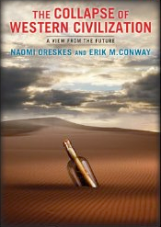
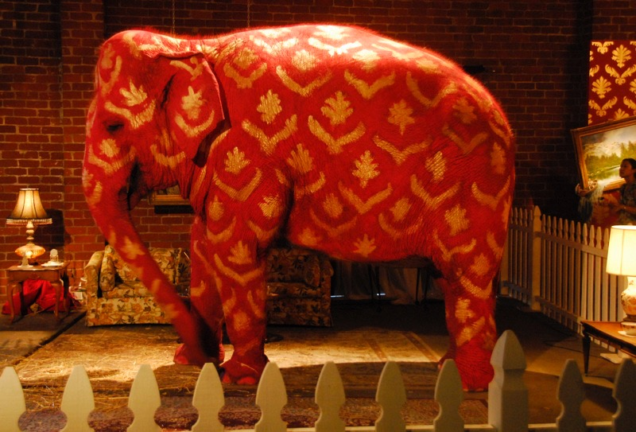
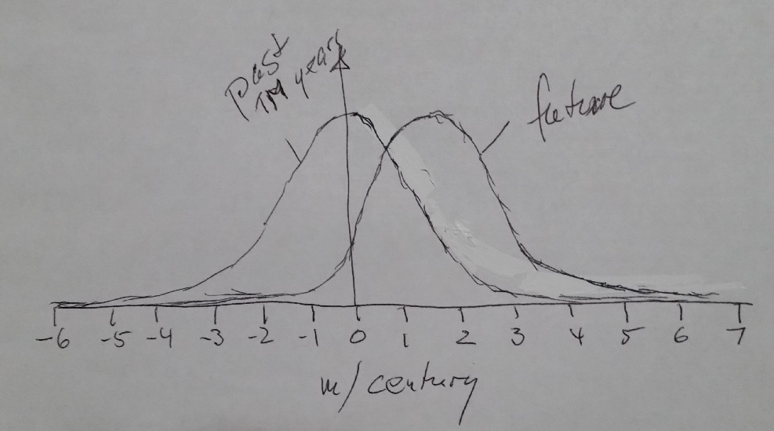
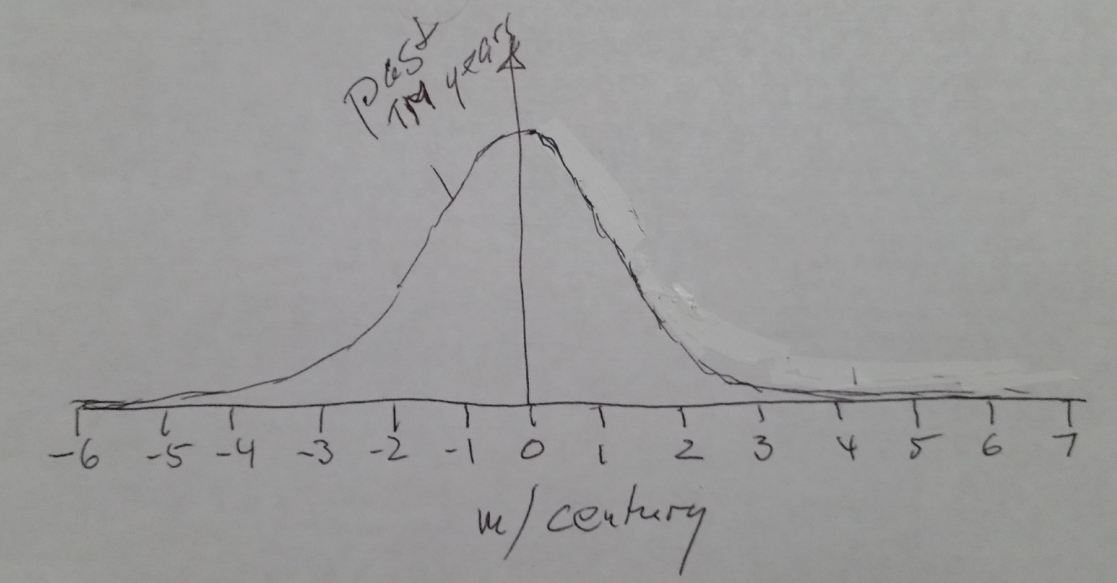
Decision Making Under Foreseeability (DMUF): Having Foresight
Planning for any limited range of plausible LSL trajectories inherently ignores part of the “probability density function” (PDF) of future LSL.
Low-probability, high-impact tail of the PDF
How large is the risk associated with the part of the PDF not considered?
MOST LIKELY VERY LARGE, BUT WE DON’T HAVE A SOLID ASSESSMENT
How likely is it that LSL might by far outside the limited range considered?
WE CANNOT EXCLUDE THIS TO HAPPEN IN THE “Post-Holocene”
How likely would that turn into a low-probability, high-impact event?
MOST LIKELY, THIS WOULD BE A GLOBAL DISASTER

Slide 16
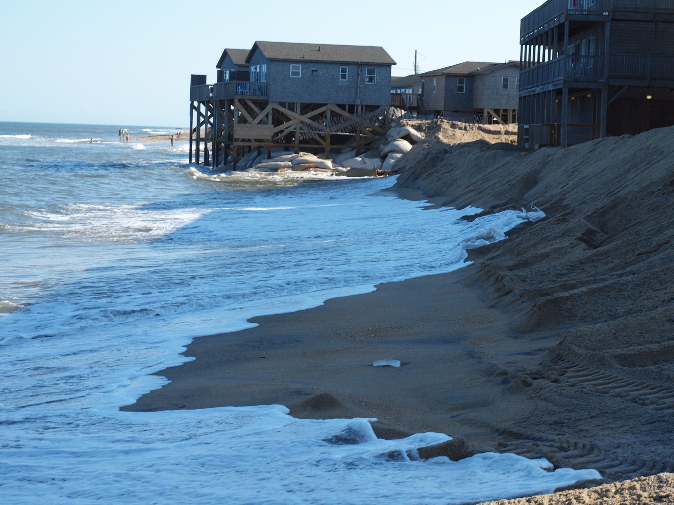
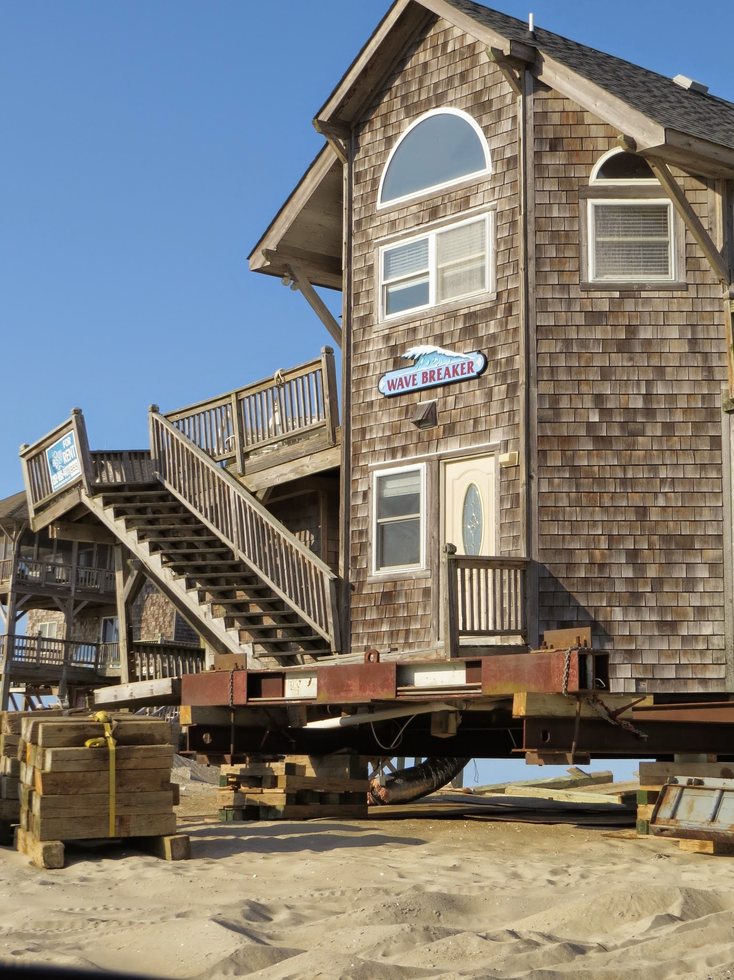
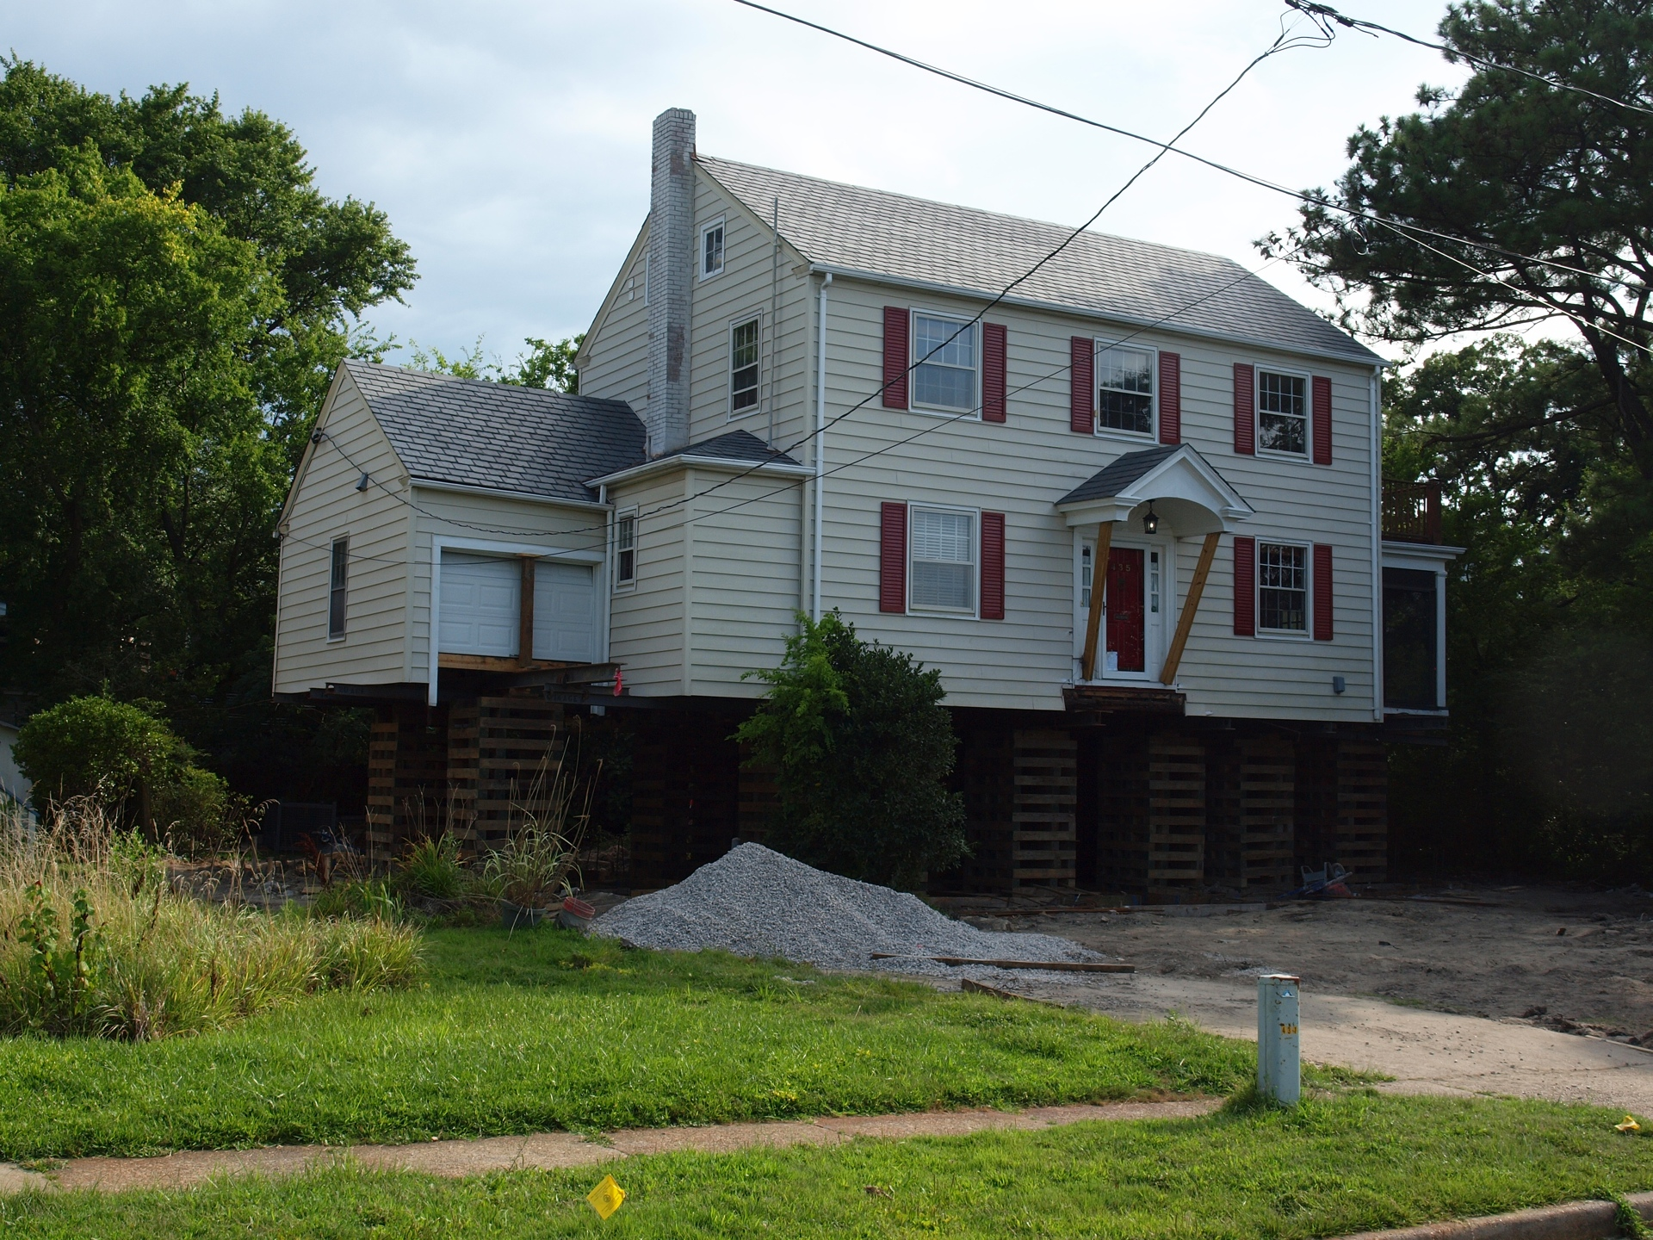
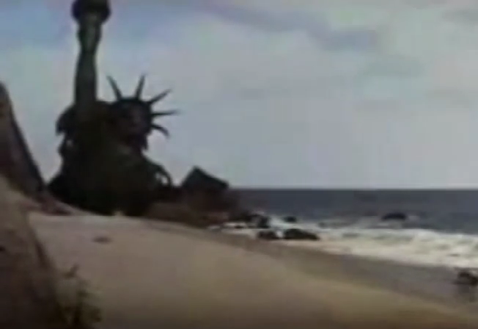
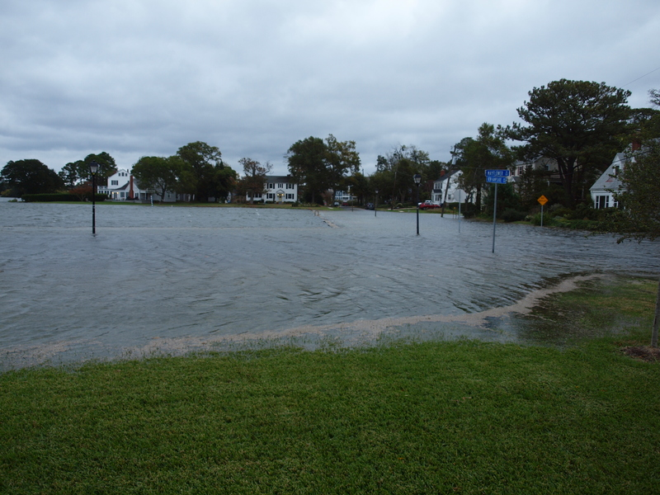
Knowing the paradigms our decision making is based on …
Example: sea level rise
Current paradigm (normalcy bias, based on 6,000 years):
“Sea level does not change very much, coastal zones change slowly, and the potential for surprises is low.”
New paradigm:
“Sea level may change rapidly and coastal zones can migrate fast.”
Consequence:
be prepared to move with the coastal zone
keep the coastal zone clean and prepared for inundation
have early warning systems in place
Necessary:
develop concepts, governance, infrastructure, and built environment that allows us to benefit from working and living in the coastal zone under changing sea levels and moving coast lines.

Slide 17
During the Holocene, climate and sea level were exceptionally stable
The Holocene was a “safe operating space for humanity”
During the last hundred years, we have introduced rapid and large changes
The system is already now outside the “normal range” and in the transition to the Post-Holocene
Our knowledge is changing very fast and we may not know all thresholds
There is a potential for surprises and we need to be prepared
Paradigm shifts may be required; for example: instead of “Sea level does not change very and changes in the coastal zone are gradual” assume “Sea level can change fast and coastal zones can migrate rapidly.”

Slide 18
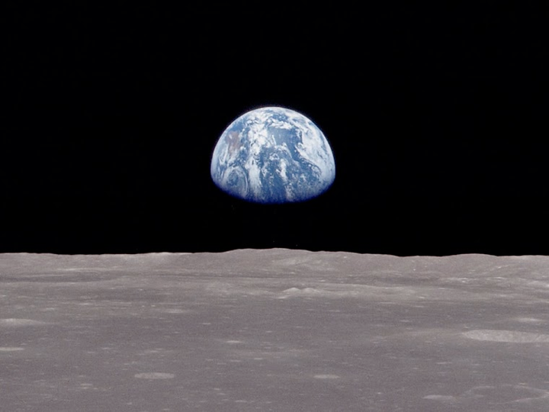
“No problem can be solved with the same consciousness that created it.”
Albert Einstein
“It is difficult to get a man to understand something when his job depends on not understanding it”
Upton Sinclair

